Slide 1


Built-in Functions
Functions and Wildcards
in MySQL Server
Functions
& Wildcards
SoftUni Team
Technical Trainers
Software University
https://softuni.bg

Slide 2
Table of Contents
Functions in MySQL
String Functions
Math Functions
Date Functions
Wildcards

Slide 3
Questions
sli.do #java-db

Slide 4

Functions in MySQL

Slide 5

SQL Functions
String Functions – for manipulating text, both from table values or user input
E.g. concatenate column values
Math Functions – calculations and working with aggregate data
E.g. perform geometry and currency operations
Date and Time Functions
E.g. find length of timespan
Other

Slide 6

String Functions

Slide 7
String Functions (1)
SUBSTRING() – extracts part of a string
SUBSTRING(String, Position)
SUBSTRING(String, Position, Length)
SUBSTRING(String FROM Position FOR Length)

Slide 8
SUBSTRING – Example
Get short summary of article
SELECT `article_id`, `author`, `content`,
SUBSTRING(`content`, 1, 200) AS 'Summary'
FROM `articles`;

Slide 9
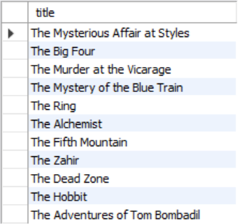
Problem: Find Book Titles
Write a query to find all book titles that start with "The"
Query book_library database

Slide 10
Solution: Find Book Titles
SELECT title FROM books WHERE SUBSTRING(title, 1, 3) = "The";

Slide 11
String Functions (2)
REPLACE – replaces specific string with another
Performs a case-sensitive match
String to replace
REPLACE(String, Pattern, Replacement)
Field from table
Replacement pattern

Slide 12
REPLACE – Example
Censor the word blood from album names
SELECT REPLACE(`title`, 'blood', '*****')
AS 'Title'
FROM `album`;

Slide 13
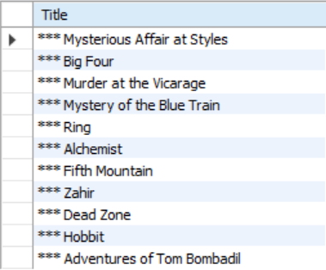
Problem: Replace Titles
Write a query to find all book titles that start with "The" and replace the substring with "***"
Query book_library database

Slide 14
Solution: Replace Titles
SELECT REPLACE(`title`, 'The', '***')
AS 'Title' FROM `books`
WHERE SUBSTRING(title, 1, 3) = 'The';

Slide 15
String Functions (3)
LTRIM & RTRIM – remove spaces from either side of string
CHAR_LENGTH – count number of characters
LENGHT – get number of used bytes (double for Unicode)
LTRIM(String)
RTRIM(String)
CHAR_LENGTH(String)
LENGTH(String)

Slide 16
String Functions (4)
LEFT & RIGHT – get characters from beginning or end of string
Example: name shorthand (first 3 letters)
LEFT(String, Count)
RIGHT(String, Count)
SELECT `id`, `start`,
LEFT(`name`, 3) AS 'Shorthand'
FROM `games`;

Slide 17
String Functions (5)
LOWER & UPPER – change letter casing
REVERSE – reverse order of all characters in string
REPEAT – repeat string
LOWER(String)
UPPER(String)
REVERSE(String)
REPEAT(String, Count)

Slide 18
String Functions (6)
LOCATE – locate specific pattern (substring) in string
INSERT – insert substring at specific position
If omitted, begins at 1
LOCATE(Pattern, String,[Position])
INSERT(String, Position, Length, Substring)
Number of characters
to delete

Slide 19

Math Functions
Arithmetical Operators and Numeric Functions

Slide 20
Arithmetical Operators
Supported common arithmetic operators
Name | Description
DIV | Integer division
/ | Division operator
- | Minus Operator
%, MOD | Modulo operator
+ | Addition operator
* | Multiplication operator
- (arg) | Change sign of argument

Slide 21
Numeric Functions (1)
Used primarily for numeric manipulation and/or mathematical calculations
PI – get the value of Pi (15 –digit precision)
ABS – absolute value
SELECT PI() +0.000000000000000
ABS(Value)

Slide 22
Numeric Functions (2)
SQRT – square root
POW – raise value to desired exponent
SQRT(Value)
POW(Value, Exponent)

Slide 23
Math Functions (1)
CONV – Converts numbers between different number bases
ROUND – obtain desired precision
FLOOR & CEILING – return the nearest integer
CONV(Value,from_base,to_base)
Can be negative
ROUND(Value, Precision)
FLOOR(Value)
CEILING(Value)

Slide 24
Math Functions (2)
SIGN – returns +1, -1 or 0, depending on value sign
RAND – get a random value in range [0,1)
If Seed is not specified, one is assigned at random
SIGN(Value)
RAND()
RAND(Seed)

Slide 25
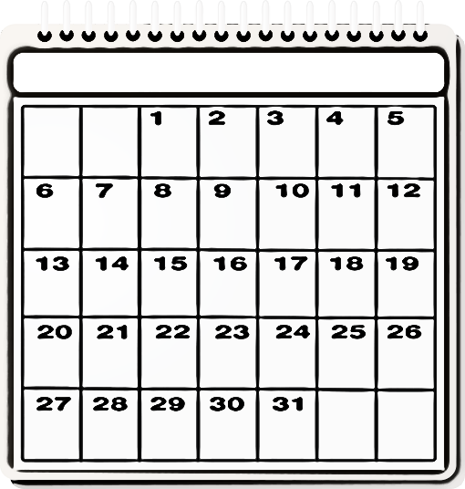
Date Functions

Slide 26
Date Functions (1)
EXTRACT – extract a segment from a date as an integer
TIMESTAMPDIFF – find difference between two dates
Part can be any part and format of date or time
EXTRACT(Part FROM Date)
TIMESTAMPDIFF(Part, FirstDate, SecondDate)
year, %Y, %y
YEAR(Date)
month, %M, %m
MONTH(Date)
day, %w, %D
DAY(Date)

Slide 27
Date Functions – Example
Show employee experience
SELECT `employee_id`, `first_name`, `last_name`,
TIMESTAMPDIFF(year, `hire_date`, '2017-05-31')
AS 'Years In Service'
FROM `employees`;

Slide 28
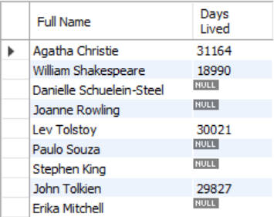
Problem: Days Lived
Write a query to calculate how many days have authors lived
Use TIMESTAMPDIFF
Query book_library database

Slide 29
Solution: Days Lived
SELECT concat(first_name, ' ', last_name) AS 'Full Name',
TIMESTAMPDIFF(DAY, born, died) AS 'Days Lived'
FROM authors;

Slide 30
Date Functions (2)
DATE_FORMAT – formats the date value according to the format
NOW – obtain current date and time
SELECT DATE_FORMAT('2017/05/31', '%Y %b %D') AS 'Date';
SELECT NOW();

Slide 31

Wildcards
Selecting Results by Partial Match

Slide 32
Wildcards
Used to substitute any other character(s) in a string
'%' - represents zero, one, or multiple characters
'_' - represents a single character
Can be used in combinations
Used with LIKE operator in a WHERE clause
Similar to Regular Expressions

Slide 33
Wildcards – Examples
Find any values that start with "a"
Find any values that have "r" in second position
Finds any values that starts with "a" and ends with "o"
WHERE customer_name LIKE 'a%';
WHERE customer_name LIKE '_r%';
WHERE customer_name LIKE 'a%o';

Slide 34
Wildcard Characters
Supported characters also include:
\ – specify prefix to treat special characters as normal
[charlist] – specifying which characters to look for
[!charlist] – excluding characters
SELECT * FROM `customers`
WHERE `city` REGEXP '[a-c]%';
"a", "b", or "c"

Slide 35
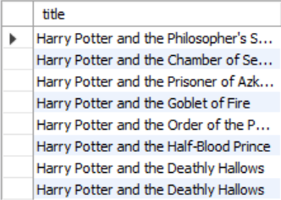
Problem: Harry Potter Books
Write a query to retrieve information about the titles of all Harry Potter books
Use Wildcards
Query book_library database

Slide 36
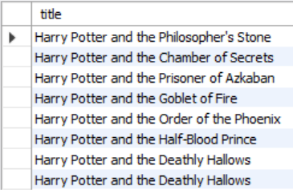
Solution: Harry Potter Books
SELECT title FROM books
WHERE title LIKE 'Harry Potter%';

Slide 37
Using Regular Expression
REGEXP - pattern matching using regular expressions
SELECT `employee_id`, `first_name`, `last_name`
FROM `employees`
WHERE `first_name` REGEXP '^\[^K\]{3}\$';
Regular expression

Slide 38

Summary
…
…
…
MySQL Server provides various built-in
functions
Numerical functions
String functions
Using Wildcards, we can obtain results by
partial string matches
Regular expressions

Slide 39
Questions?
Notes:
39

Slide 40













SoftUni Diamond Partners

Slide 41

Educational Partners

Slide 42
Trainings @ Software University (SoftUni)
Software University – High-Quality Education, Profession and Job for Software Developers
softuni.bg, about.softuni.bg
Software University Foundation
softuni.foundation
Software University @ Facebook
facebook.com/SoftwareUniversity
Software University Forums
forum.softuni.bg
Notes:
42

Slide 43

License
This course (slides, examples, demos, exercises, homework, documents, videos and other assets) is copyrighted content
Unauthorized copy, reproduction or use is illegal
© SoftUni – https://about.softuni.bg/
© Software University – https://softuni.bg
Notes:
43

